Slide 1
Trusted SLA-Guided Data Integration on Multi-cloud Environments
Project funded by ARC 6
Daniel A S Carvalho, Magellan, IAE, Univ. J. Moulin Lyon 3, France
Chirine Ghedira-Guegan, Magellan, IAE, Univ. J. Moulin Lyon 3, France
Nadia Benani, LIRIS-CNRS, INSA-Lyon, Univ. Lyon, France
Genoveva Vargas-Solar, CRNS, LIG-LAFMIA, France

Slide 2
Agenda
Context and Challenges
Work done in the 1st year: systematic mapping
Ongoing work: query rewriting algorithm
Conclusions and Future works
Notes:
The agenda of my presentation...

Slide 3
Context and Challenges
Data integration x Cloud computing
Classical data integration scenario
Query
Result
Mediator
Data source A
Data source B
Data source C

Slide 4
Quality oriented data integration
Query
Result
(Quality preferences)
Mediator
Data provider A
SLA
Data provider B
SLA
Data provider C
SLA
Notes:
Now we can see a new scenario for data integration... where we have different data providers A, B and C geographically disposed on different clouds. In the cloud scenario quality aspects are defined and agreed between the service provider and the service customer through contracts.
Service level agreements (SLA) is an example of these contracts.
As in the classical scenario we have a query that must be answered and this query is submitted to a mediator who will rewrtite it in accordance with the different data providers and the result will be integrated to be sent back to the user.
In this scenario we have some limitations and challenges such as:
* we have different SLAs schemas exported by the providers
* we have different level of SLAs... such as SLAs between the user and the data provider, SLA between the data provider and the cloud, and also SLAs between different data providers..
* we have different measures in different SLAs which have the same meaning
considering this new scenario, the use of SLA on data integration approaches is an open challenge and we believe that the quality on this approaches can be enhanced

Slide 5
Quality oriented data integration
Query
Result
Which services should I select? Are the requirements being respected?
(Quality preferences)
How to be sure that all SLAs are being respected?
Mediator
How to integrate different SLAs associated to services with user’s preferences?
How results can be reused for a next query?
In this new scenario, we believe that the quality on data integration could be enhanced by using SLA contracts
Data provider A
SLA
Data provider B
SLA
Data provider C
SLA
Notes:
Now we can see a new scenario for data integration... where we have different data providers A, B and C geographically disposed on different clouds. In the cloud scenario quality aspects are defined and agreed between the service provider and the service customer through contracts.
Service level agreements (SLA) is an example of these contracts.
As in the classical scenario we have a query that must be answered and this query is submitted to a mediator who will rewrtite it in accordance with the different data providers and the result will be integrated to be sent back to the user.
In this scenario we have some limitations and challenges such as:
* we have different SLAs schemas exported by the providers
* we have different level of SLAs... such as SLAs between the user and the data provider, SLA between the data provider and the cloud, and also SLAs between different data providers..
* we have different measures in different SLAs which have the same meaning
considering this new scenario, the use of SLA on data integration approaches is an open challenge and we believe that the quality on this approaches can be enhanced

Slide 6
Challenge:
Query rewriting such that it matches the services that can provide data to build final results
Existing works:
MiniCon algorithm (Pottinger and Halevy, 2001) for query rewriting
Query rewriting techniques adapted to service composition
List of green energy providers that can provision 1000 kWh, in the next 10 seconds, that are close to my city with a cost of 0,15 USD/kWh?
Look up Hubs
Locate
KNN
Sum
1000KWh, 0,15USD
[1] Pottinger, R. and Halevy, A. Y. (2001). Minicon: A scalable algorithm for answering queries using views. VLDB J., 10(2-3):182–198.
Energy provision
services
Energy provision Hub
<ID, Region, kW/rate,cost>
< av, TaF,
<$/Kwatt, [t1,t2]>
>
[2] Barhamgi, M., Benslimane, D., and Medjahed, B. (2010). A query rewriting approach for web service composi- tion. IEEE T. Services Computing, 3(3):206–222.
[3] da Costa, U. S., Alves, M. H. F., Musicante, M. A., and Robert, S. (2013). Automatic refinement of service compositions. In Daniel, F., Dolog, P., and Li, Q., editors, ICWE, volume 7977 of Lecture Notes in Com- puter Science, pages 400–407. Springer.
[4] Zhao, W., Liu, C., and Chen, J. (2011). Automatic compo- sition of information-providing web services based on query rewriting. Science China Information Sciences, pages 1–17.
< av, TaF,
<$/Kwatt, [t1,t2]>
>
Location
services
< av, TaF,
<$/Kwatt, [t1,t2]>
>
< av, TaF,
<$/Kwatt, [t1,t2]>
>
Smart meters
<ID, Loc, kW/rate, cost>
Notes:
For example, a consumer can state the following requirement:
List of green energy providers that can provision 1000 kWh, in the next 10 seconds, that are close to my city with a cost of 0,15 USD/kWh?
If we read this requirement as a query on available services deployed on a service infrastructure:
The challenge is to rewrite it coordinating the services that can participate to answer it (click)
Such coordination could look like a recurrent workflow consisting of 4 sequential activities :
One for looking up for hubs that will put in contact with energy services
The next activities for locating the services and filtering the k closest to her city as stated by the request
The last one for computing the total cost
And since energy is constantly required, the request is conitnuous and it starts over again
Query rewriting is a well known problem in databases, the challenge in this case is to rewrite the query such that it matches the services that can provide data to build final results
There are works addressing the problem by
revisting well known algorithms such as MiniCon and
for query rewriting adapted to services composition.

Slide 7

List of green energy providers that can provision 1000 kWh, in the next 10 seconds, that are close to my city with a cost of 0,15 USD/kWh?
Maximum of $5 as total query cost
Only green energy providers (provenance)
At least 85% of precision of provided data, ^{even if they are not fresh}
Availability rate of at least 90%
^{Response time of 0,01 sec.}
Challenge:
Integrate the agreed SLAs with the QoS requirements expressed by the user → Derived SLA
Existing works:
Negotiation of use conditions, which are statically agreed between the parts [1]–[3]
Monitoring of use conditions as cloud resources are used, to detect SLA contracts violation [4], [5]
Look up Hubs
Locate
KNN
Sum
1000KWh, 0,15USD
Agreed
SLA
Energy provision
services
Energy provision Hub
Agreed
SLA
<ID, Region, kW/rate,cost>
[1] V. Emeakaroha, I. Brandic, M. Maurer, and S. Dustdar, “Low level metrics to high level slas - lom2his framework: Bridging the gap between monitored metrics and sla parameters in cloud environments,” in HPCS 2010, 2010, pp. 48–54.
[2] A. V. Dastjerdi, S. G. H. Tabatabaei, and R. Buyya, “A dependency-aware ontology-based approach for deploying ser- vice level agreement monitoring services in cloud,” Softw. Pract. Exper., vol. 42, no. 4, pp. 501–518, Apr. 2012.
[3] J. Ortiz, V. T. de Almeida, and M. Balazinska, “A vision for personalized service level agreements in the cloud,” in Proc.2nd Workshop on Data Analytics in the Cloud. pp. 21–25.
< av, TaF,
<$/Kwatt, [t1,t2]>
>
< av, TaF,
<$/Kwatt, [t1,t2]>
>
Location
services
< av, TaF,
<$/Kwatt, [t1,t2]>
>
< av, TaF,
<$/Kwatt, [t1,t2]>
>
Smart meters
<ID, Loc, kW/rate, cost>
[4] M. Hale and R. Gamble, “Secagreement: Advancing security risk calculations in cloud services,” in IEEE SERVICES, 2012, pp. 133–140.
[5] I. Brandic, V. Emeakaroha, M. Maurer, S. Dustdar, S. Acs, A. Kertesz, and G. Kecskemeti, “Laysi: A layered approach for sla-violation propagation in self-manageable cloud infras- tructures,” in IEEE COMPSACW, 2010, pp. 365–370.
Notes:
Yet in our work we want the query evaluation to be guided by service level agreements. For example, the user asks that the query will not cost more than 5 USD
That only green energy providers are contacted (this is a provenance requirement) At least 85% of precision of provided data, even if they are not fresh
Availability rate of at least 90%
Response time of 0,01 sec
Le défi consiste à intégrer les SLA convenus avec les exigences de qualité de service exprimées par l'utilisateur
The challenge is to Integrate the agreed SLAs with the QoS requirements expressed by the user → Derived SLA
Existing works addressing the problem can be classified into two groups:
Those addressing negociation of use condition which are statically agreed between the parts and those monitoring of use conditions as
Cloud resources to detect SLA contract violation

Slide 8
General Approach
Query rewriting
SLA derivation
Service composition
Query evaluation
Lookup
prederived SLA
Rewrite query with SLA constraints
SLA guided
optimization
OR
SEQ
SEQ
Integrate
SLA
Store rewriten queries
Execution
SLA
management
Monitoring
Notes:
To attempt those objectives, Our general approach looks as follows:
Given that a query has associated preferences, the query evaluation process is divided in 3 phases
Phase one: SLA derivation, that consists in looking up whether a similar SLA has been already derived for a similar request, if not we compute an integrated SLA
Phase two: Service composition, the query is expressed as a workflow with associated SLA constraints specified in the derived SLA. The rewriting result is stored for further uses
Phase three: the query is optimized in terms to other elements of SLA requirements that have more to do with the consumed resources and the economic
Cost of the query. Once optimized the query is enacted by a workflow engine.
Since SLA are contracts, there is a monitoring mechanism and an SLA management module devoted to observing whether the SLAs are honoured
The paper we present focuses mainly on the SLA derivation approach. So let us zoom on this aspect:

Slide 9
Objective
The objective is to propose a data integration solution in a multi-cloud environment guided by user preferences and SLA exported by different clouds.

Slide 10
Work done in the 1st year: systematic mapping
Categorize and quantify the key contributions and the evolution of the research done on SLA-guided data integration in a multi-cloud environment
Discover open issues and limitations of existing works

Slide 11
SM Process
Definition of research question
Conduct search
Papers screening
Keywording using abstracts
Data extraction and mapping process
Review scope
All papers
Research papers
Classification scheme
Systematic map
Notes:
The process consists in five steps, from the definition of resarch questions to the generation of quantitative vision of the state of the art. Each phase produces a concrete result that will eventually help to perform an analytic study and a state of the art of the field.
I will describe briefly each phase and show concretely what we did in our work.

Slide 12
SM Process
Definition of research question
Conduct search
Papers screening
Keywording using abstracts
Data extraction and mapping process
Review scope
All papers
Research papers
Classification scheme
RQ1: Which are the SLA measures that have been mostly applied in the cloud?
RQ2: How have published papers on data integration evolved towards cloud topics?
RQ3: In which way and in which context data integration have been used to Quality of Service (QoS) measures in the literature?
Systematic map
Notes:
The process consists in five steps, from the definition of resarch questions to the generation of quantitative vision of the state of the art. Each phase produces a concrete result that will eventually help to perform an analytic study and a state of the art of the field.
I will describe briefly each phase and show concretely what we did in our work.

Slide 13
SM Process
Definition of research question
Conduct search
Papers screening
Keywording using abstracts
Data extraction and mapping process
Review scope
All papers
Research papers
Classification scheme
Systematic map
Notes:
The process consists in five steps, from the definition of resarch questions to the generation of quantitative vision of the state of the art. Each phase produces a concrete result that will eventually help to perform an analytic study and a state of the art of the field.
I will describe briefly each phase and show concretely what we did in our work.

Slide 14
SM Process
Definition of research question
Conduct search
Papers screening
Keywording using abstracts
Data extraction and mapping process
Review scope
All papers
Research papers
Classification scheme
Data integration environment: cloud, data warehouse, federated database and multi-cloud.
Data integration description: schema, meta-data and knowledge.
Data quality: confidentiality, privacy, security, SLA, data protection, data provenance and others
Systematic map
Notes:
The process consists in five steps, from the definition of resarch questions to the generation of quantitative vision of the state of the art. Each phase produces a concrete result that will eventually help to perform an analytic study and a state of the art of the field.
I will describe briefly each phase and show concretely what we did in our work.

Slide 15
SM Process
Definition of research question
Conduct search
Papers screening
Keywording using abstracts
Data extraction and mapping process
Review scope
All papers
Research papers
Classification scheme
Systematic map
Notes:
The process consists in five steps, from the definition of resarch questions to the generation of quantitative vision of the state of the art. Each phase produces a concrete result that will eventually help to perform an analytic study and a state of the art of the field.
I will describe briefly each phase and show concretely what we did in our work.

Slide 16
Mapping results
Notes:
Recall the first research question intended to identify the SLA measures that have been mostly applied in the cloud
Therefore we combined three categories of our proposed classification scheme the one concerning quality measures, data integration description and data integration environment. Aggregating papers dealing with these categories, whe observed that click
Privacy
SLA

Slide 17
Mapping results
Notes:
Finally, research question number three explored in which way and context has data integration been used with QoS measures
Three categories were coupled again: Data integration environment, data integration description and Measures, since Quality can be considered both while describing data integration strategies and within specific architectures. Concretely the cloud and multi – cloud are the architectures that most consider QoS … but in fact few papers address both aspects, and some issues seem still open.

Slide 18
Mapping results
Notes:
The objective of the second research question was to observe the evolution of publication trends towards the cloud, and how it was related to SLA issues. We observed that
SLA publications emerged when
The # of publications

Slide 19
Mapping results
Notes:
Other interesting observations were analyzed by combining the data integration Environments, with the type of contributions and research developed. The analysis shos that
The cloud is …
Of course the paper referes and argues about other observations and combinations of categories that lead to have a quite interesting picture of works addressing data integration, in multi-cloud conditions and that integrate SLA or some QoS measures to it. Due to time let us rather try to give elements to answer the initial question:

Slide 20
Lessons & Contribution
Trends and open issues on SLA guided multi-cloud data integration show that
Quality understood by the user and the cloud provider must be integrated under the same vision, in this case the SLA’s
SLA assessment must be integrated within the whole data integration process
Data integration classification scheme that
characterizes a:
modern vision of data integration in multi-cloud environments
enhanced by including SLAs in its process
is supported by the analysis of the literature considering the most popular paper databases and applying the SM method
Notes:
Trends and ....
So the contribution of this paper is a data integration classification scheme that:
-characterizes a:
Is supported by ...

Slide 21
Work in progress
Query rewriting is the core of data integration solutions
Different algorithms proposed to different domains
Early steps on developing our algorithm
Our solution is now working on a single cloud
Configuring a multi-cloud infrastructure to test our algorithm

Slide 22
Rhone service-based query rewriting algorithm
Problem addressed: given a set of abstract services, a set of concrete services, a user query and a set of quality preferences
Derive a set of service compositions that answer the query and fulfil the quality requirements.

Slide 23
Rhone service-based query rewriting algorithm
Originality:
The user can express her quality preferences and associate them to her queries
Service’s quality aspects are defined on Service Level Agreements (SLA) guide service selection and the whole rewriting process

Slide 24
Rhone service-based query rewriting algorithm
Steps:
Select candidate concrete services
Create mappings from concrete services to the query (Concrete service description - CSD)
Combine CSDs
Produce rewritings

Slide 25
Rhone service-based query rewriting algorithm (Formalization)
Input data: (1) a query; and (2) a list of concrete services
Definition 1 (Query):
Q(I, O) := A₁(I, O), A₂(I, O), .., A_{n}(I, O), C₁, C₂, .., C_{m}[P₁, P₂, .., P_{k}]
C and P are in the form: name operation value
<, >, ≤, ≥, ≠ and =

Slide 26
Rhone service-based query rewriting algorithm (Formalization)
Example:
Single measure: availability, price per call, price per request, response time, location, provenance, etc.
Composite measure: total price or cost which are computed by adding price per call and price per request values of all services included in the service composition. Total response time is computed by adding the response time of all services included in the service composition.
Quality Preferences P (or measures) can be:
Single measure: static measure associated to the service
Composed measure: dynamically computed measures associated to a rewriting. It is based on aggregations of single measures

Slide 27
Rhone service-based query rewriting algorithm (Formalization)
Abstract Services Available
Abstract Service | Description
DiseaseInfectedPatient (d?, p!) | Given a disease d, it retrieves patients p
DiseaseInfectedPatient (d?, p!, op!) | Given a disease d, it retrieves patients p, and op is an optional boolean output indicating if the operation proceeded well or not.
PatientDNA (p?, dna!) | Given a patient p, it retrieves DNA dna
PatientPersonalInformation (p?, info!) | Given a patient p, it retrieves patient’s personal information info
Considering that we have the following pre-defined abstract services:

Slide 28
Rhone service-based query rewriting algorithm (Formalization)
The user wants to retrieve patient’s personal and DNA information who were infected by a disease «K» using services that have availability higher than 98%, price per call less than 0.2 dollars, and total cost less then 1 dollar.
Q(disease?, patientInfo!, dna!) := DiseaseInfectedPatient (d?, p!), PatientPersonalInformation (p?, info!), PatientDNA (p?, dna!) [availability > 98, price per call < 0.2, total cost < 1]

Slide 29
Rhone service-based query rewriting algorithm (Formalization)
Definition 2 (Concrete services):
S(I, O) := A₁(I, O), A₂(I, O), .., A_{n}(I, O) [P₁, P₂, .., P_{k}]
P are in the form: name operation value
P represents the SLA exported by the concrete service
S do not have composed measures

Slide 30
Rhone service-based query rewriting algorithm (Formalization)
S1(a?,b!) = DiseaseInfectedPatient (a?,b!) [availability > 98]
S2(a?,b!) = DiseaseInfectedPatient (a?,b!) [availability > 98, price per call = 0.2]
S3(a?,b!) = DiseaseInfectedPatient (a?,b!) [availability > 98, price per call = 0.1]
S4(a?,b!) = PatientPersonalInformation (a?,b!) [availability > 98, price per call = 0.1]
S5(a?,b!) = PatientDNA (a?,b!) [availability > 99, price per call = 0.1, location = “close”]
S5(a?,b!) = DiseaseInfectedPatient (a?,c!), PatientPersonalInformation (c?,b!) [availability > 99, price per call = 0.1]
S5(a?,b!,c!) = DiseaseInfectedPatient (a?,p!), PatientPersonalInformation (p?,b!), PatientDNA (p?,c!) [availability > 99, price per call = 0.1]
According to the example, let us suppose the following concrete services:

Slide 31
Rhone service-based query rewriting algorithm (Formalization)
Definition 3 (measures matching):
All single measures in the query must exist in the concrete service, and all of them can not violate the measures in the query.
Definition 4 (abstract service matching):
An abstract service A can be matched with an abstract service B only if
(a) they have the same name; and
(b) they have a compatible number and type of variables

Slide 32
Rhone service-based query rewriting algorithm (Formalization)
Definition 5 (concrete service matching):
A concrete service can be matched with the query if all its abstract services satisfy the abstract service matching problem and all the single measures satisfy the measures matching problem.

Slide 33
Rhone service-based query rewriting algorithm (Formalization)
S1(a?,b!) = DiseaseInfectedPatient (a?,b!) [availability > 98]
S2(a?,b!) = DiseaseInfectedPatient (a?,b!) [availability > 98, price per call = 0.2]
S3(a?,b!) = DiseaseInfectedPatient (a?,b!) [availability > 98, price per call = 0.1]
S4(a?,b!) = PatientPersonalInformation (a?,b!) [availability > 98, price per call = 0.1]
S5(a?,b!) = PatientDNA (a?,b!) [availability > 99, price per call = 0.1, location = “close”]
S5(a?,b!) = DiseaseInfectedPatient (a?,c!), PatientPersonalInformation (c?,b!) [availability > 99, price per call = 0.1]
S5(a?,b!,c!) = DiseaseInfectedPatient (a?,p!), PatientPersonalInformation (p?,b!), PatientDNA (p?,c!) [availability > 99, price per call = 0.7]
Considering our concrete services in the example;

Slide 34
Rhone service-based query rewriting algorithm (Formalization)
Definition 6 (concrete service description):
Describes how a candidate concrete service can be used in the query rewriting process.
It includes:
Mappings from variables in a concrete service to variables in the query
Mappings from variables on the head of a concrete service to variables on its body
A set of abstract services that represents partially or fully the abstract services in the query
A set of quality constrains associated to the concrete service.

Slide 35
Rhone service-based query rewriting algorithm (Formalization)
Definition 6 (concrete service description):
A CSD is represented by an n-tuple:
‹S, h, ϕ, G, P›
S is a concrete service.
h are mappings between variables in the head of S to variables in the body of S.
ϕ are mapping between variables in the concrete service to variables in the query.
G is a set of abstract services covered by S.
P is a set quality constraints associated to the service S.

Slide 36
Rhone service-based query rewriting algorithm (Formalization)
Definition 6 (concrete service description):
Rule 1: head and local variables in the concrete service can be mapped to head variables in the query if they are from the same type
Rule 2: local variable in the concrete service can be mapped to a local variable in the query if: (i) they are from the same type; and (ii) the concrete service cover all abstract service in the query that depends on this variable. “Depends” here means that this local variable is used as input in another abstract service.
Q(a?,b!,c!) := S1(a?,b!) S2(p?,c!)

Slide 37
Rhone service-based query rewriting algorithm (Formalization)
S3(a?,b!) = DiseaseInfectedPatient (a?,b!) [availability > 98, price per call = 0.1]
S4(a?,b!) = PatientPersonalInformation (a?,b!) [availability > 98, price per call = 0.1]
S5(a?,b!) = PatientDNA (a?,b!) [availability > 99, price per call = 0.1, location = “close”]
S5(a?,b!) = DiseaseInfectedPatient (a?,c!), PatientPersonalInformation (c?,b!) [availability > 99, price per call = 0.1]
S5(a?,b!,c!) = DiseaseInfectedPatient (a?,p!), PatientPersonalInformation (p?,b!), PatientDNA (p?,c!) [availability > 99, price per call = 0.7]
Considering our example:

Slide 38
Rhone service-based query rewriting algorithm (Formalization)
S3(a?,b!) = DiseaseInfectedPatient (a?,b!) [availability > 98, price per call = 0.1]
S4(a?,b!) = PatientPersonalInformation (a?,b!) [availability > 98, price per call = 0.1]
S5(a?,b!) = PatientDNA (a?,b!) [availability > 99, price per call = 0.1, location = “close”]
S6(a?,b!,c!) = DiseaseInfectedPatient (a?,p!), PatientPersonalInformation (p?,b!), PatientDNA (p?,c!) [availability > 99, price per call = 0.7]
Definition 7 (valid rewriting):
A valid rewriting is a set of CSDs that:
Entirely covers the query
There is no CSD in duplicity
There are mappings for all variables
Rewritings:
Q(disease?, patientInfo!, dna!) = S3 (disease?,p!) S4 (p?, patientInfo!) S5 (p?,dna!)
Q(disease?, patientInfo!, dna!) = S6 (disease?, patientInfo!, dna!)

Slide 39
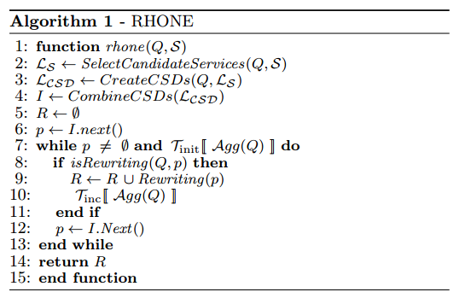
Rhone service-based query rewriting algorithm
Rewritings:
Q(disease?, patientInfo!, dna!) = S3 (disease?,p!) S4 (p?, patientInfo!) S5 (p?,dna!)
Q(disease?, patientInfo!, dna!) = S6 (disease?, patientInfo!, dna!)

Slide 40
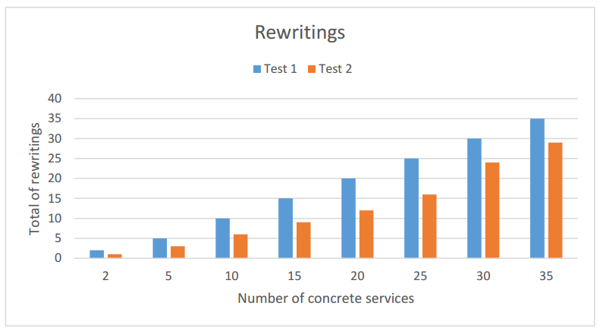
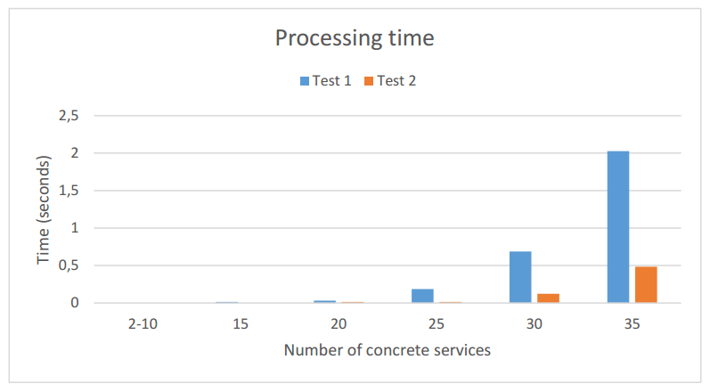
Preliminary results

Slide 41
Conclusions and Future works
The idea regarding my thesis project
Context and challenges
The work done during the 1st year
Systematic mapping and Article
The ongoing work concerning the algorithm
Improving the algorithm and producing experiments
Cost model for query rewriting

Slide 42
Thank you for your attention!
Questions? Opinions?
They are welcome! ☺

